Slide 1
Circuit Analysis

Slide 2
In this Smart Lesson you will learn to:
Define power dissipation over resistors in a circuit.
Solve problems involving electrical potential difference, electric current, resistance and power.
Recall resistor, voltmeter, ammeter, cell, battery, switch and bulb circuit diagram symbols.
Recognise series and parallel connections of components in electrical circuits.
Solve problems involving finding equivalent resistance, electrical potential difference and electric currents in series and parallel circuits.

Slide 3
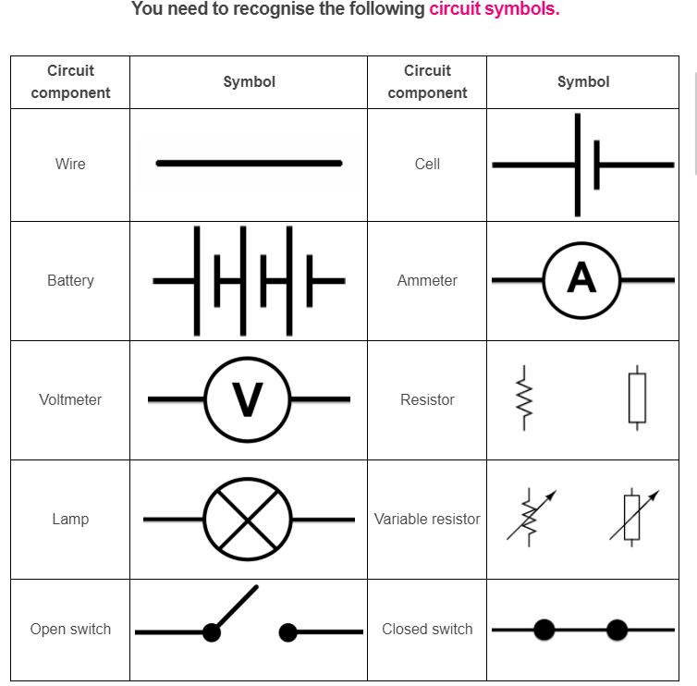

Slide 4
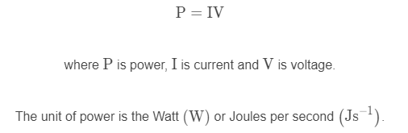
Power dissipation.
Power dissipation is defined as a measure of the rate at which energy is lost from an electrical system.
Power dissipation of a resistor can be calculated using the formula:

Slide 5
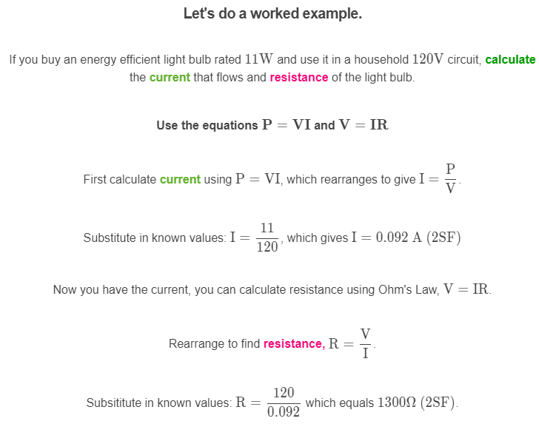

Slide 6
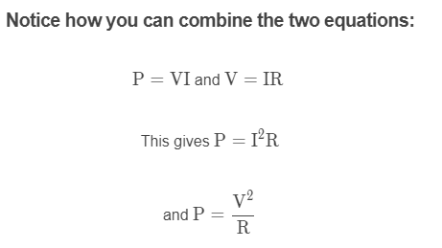

Slide 7
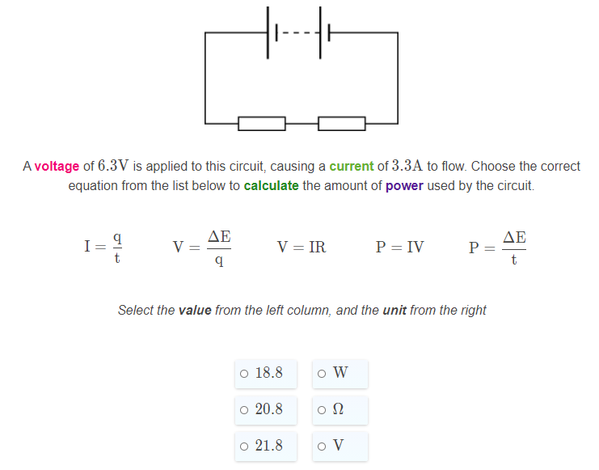

Slide 8
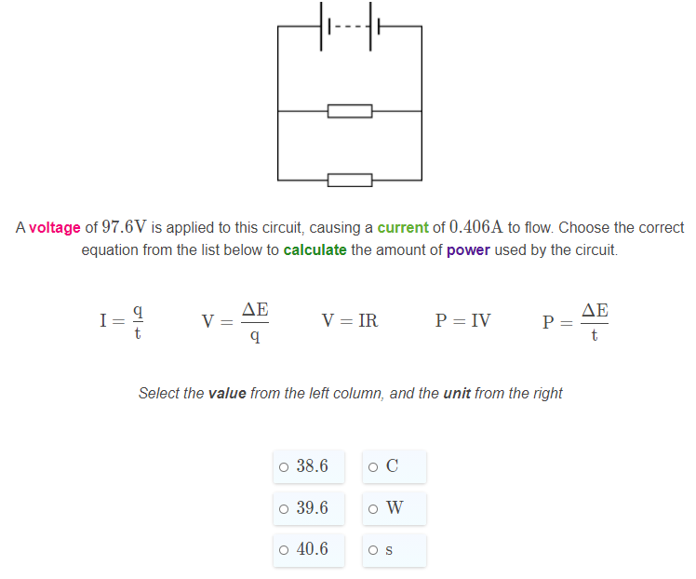

Slide 9
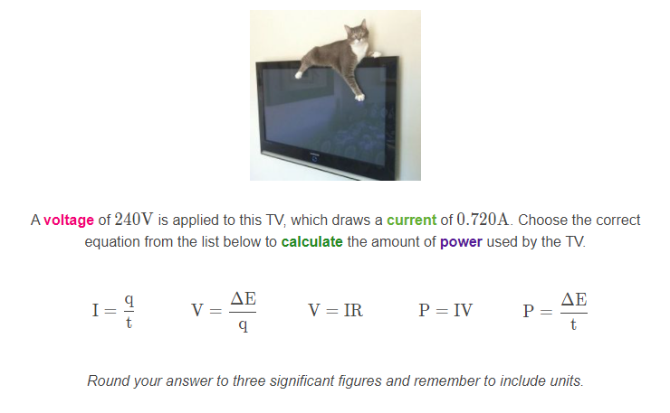

Slide 10
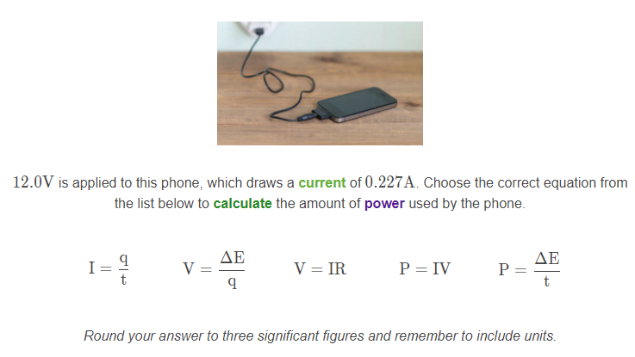

Slide 11
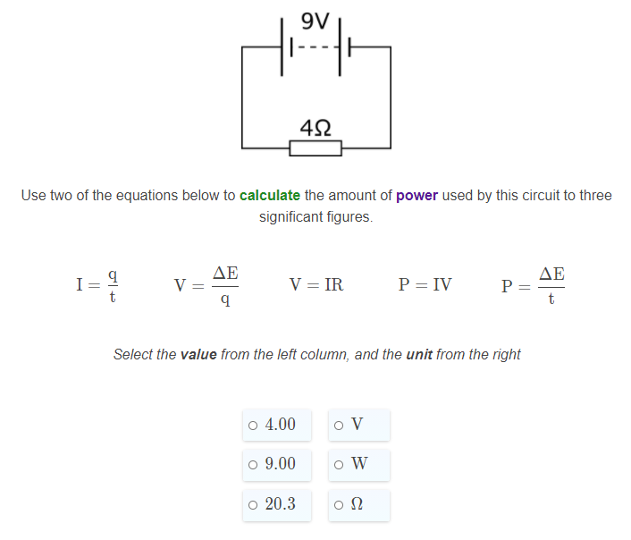

Slide 12
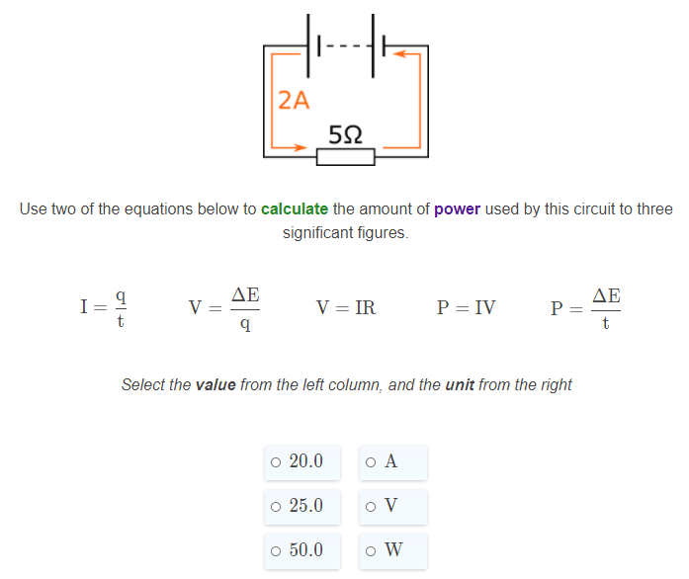

Slide 13
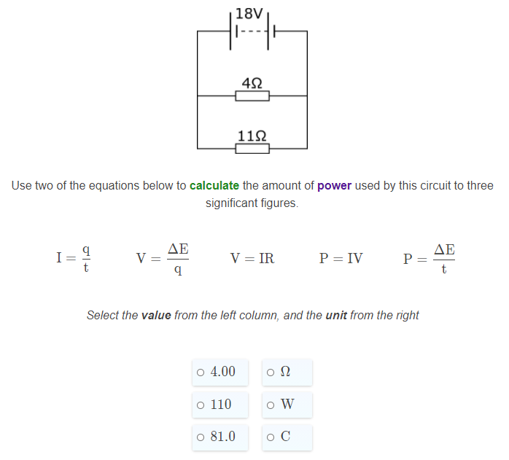

Slide 14
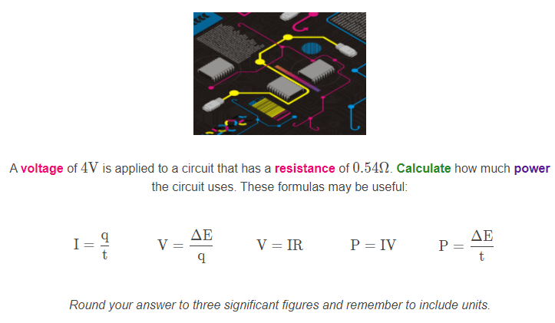

Slide 15
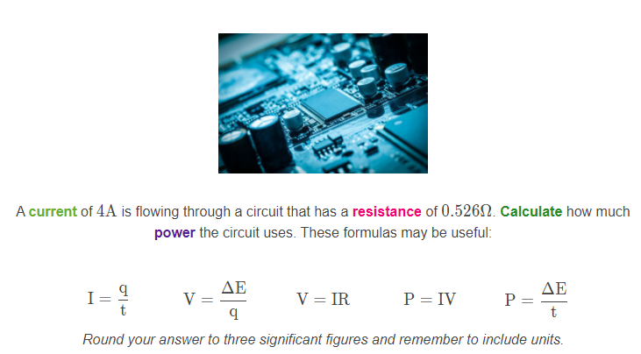

Slide 16
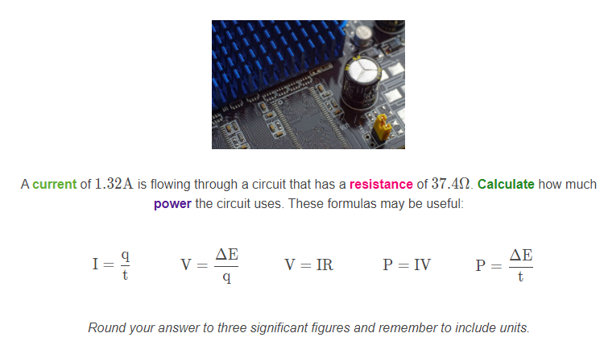

Slide 17
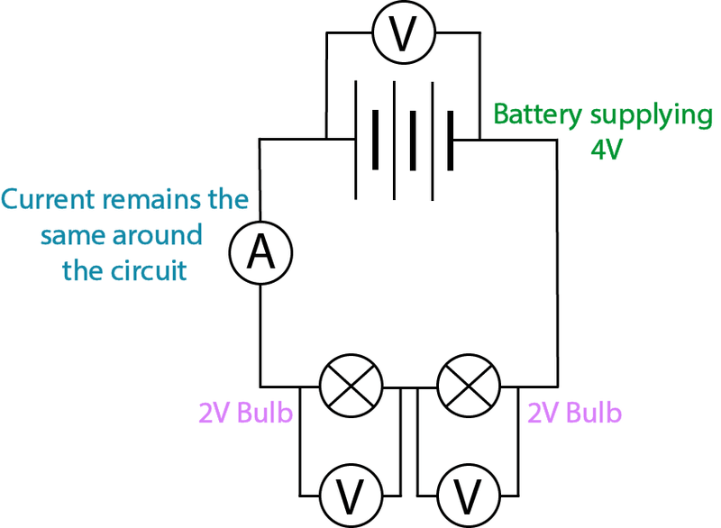
Voltage and current behave differently in series circuits and parallel circuits.
In series circuits, each component has the same current through them. This is because there is only one path for the current to flow along.
However, voltage is split up in series circuits. The voltage across each component depends on the resistance of the component.

Slide 18
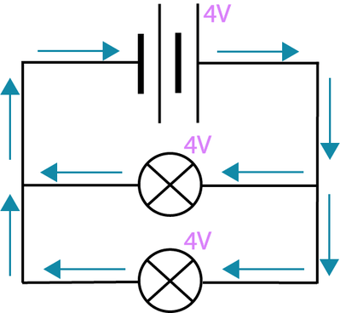
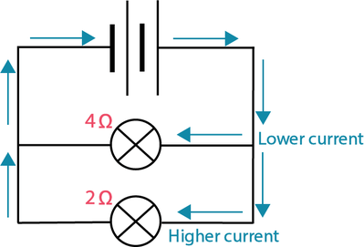
Current and voltage behave differently in parallel circuits.
Branches in parallel circuits have the same voltage across them.
However, the current is split up in these circuits. This is because there are multiple paths for the current to flow down, but each electron can only go down one branch at a time.

Slide 19
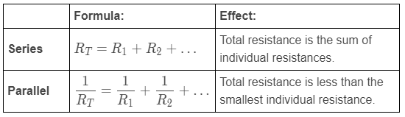
Simplifying resistance.
Whether multiple resistors are in series or parallel with each other affects how we do calculations with them. The total or combined resistance (R_{T}​) of two or more individual resistors can be found by using the formulae in the table below.

Slide 20
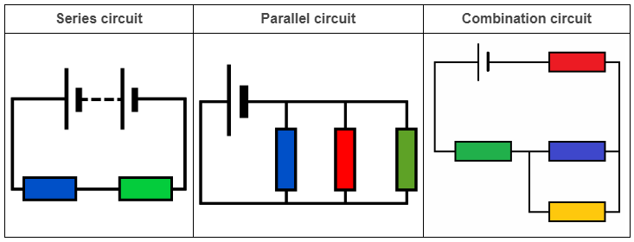
Types of circuit.
When all components are connected in series, the circuit is described as a series circuit.
When all components are connected in parallel, the circuit is described as a parallel circuit.
When you have both components connected in series and in parallel, the circuit is described as a combination circuit. The more components you have, the more connections there are between them, and the more complex the circuit becomes.

Slide 21
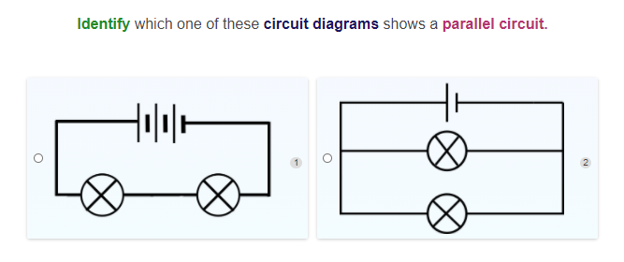

Slide 22
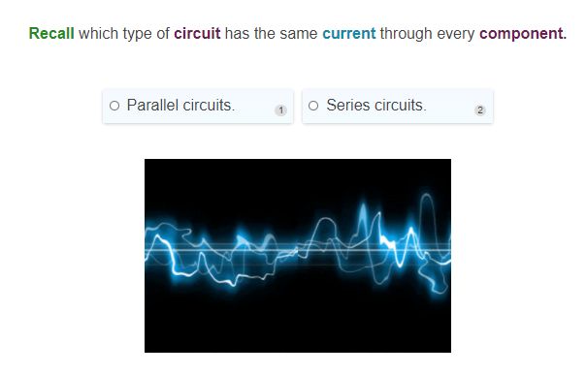

Slide 23
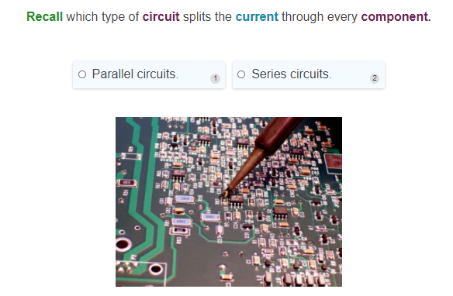

Slide 24
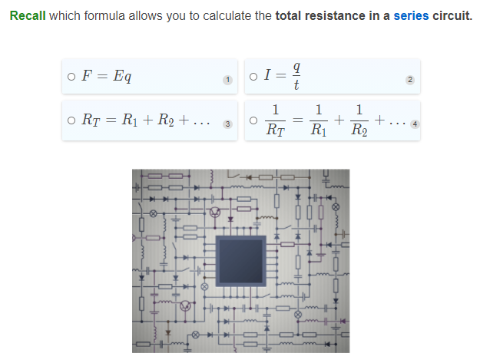

Slide 25
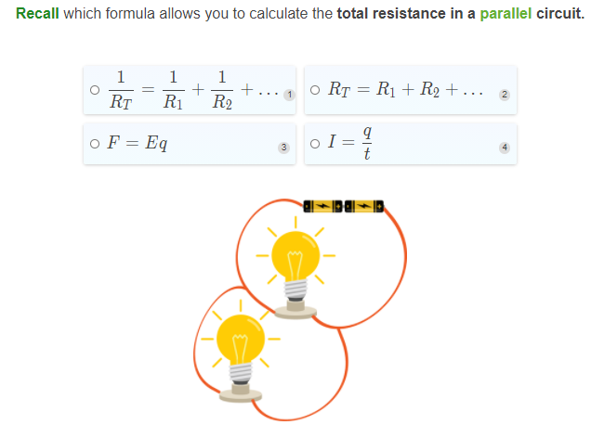

Slide 26
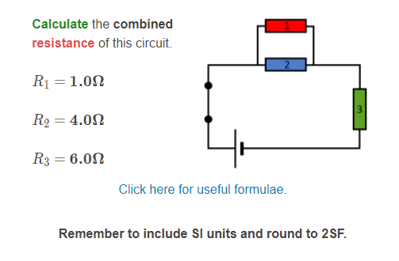

Slide 27
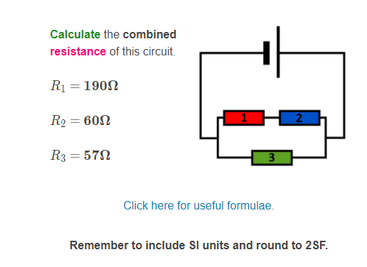

Slide 28
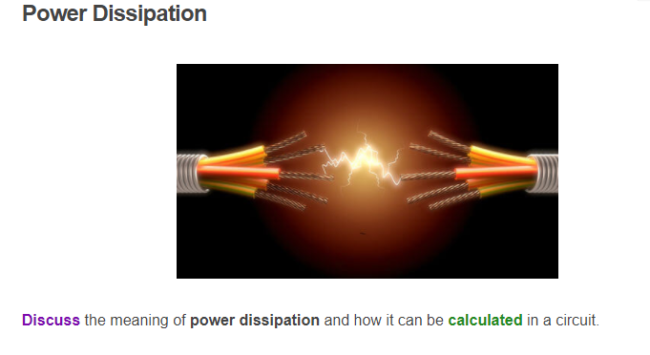

Slide 29
